Slide 1

UiPath Task Capture
Waleed Tariq

Slide 2

Agenda
Overview of Task Capture
Key Features of Task Capture
How to Use Task Capture
Benefits and Use Cases
Integration with UiPath Studio
Task Capture vs. Traditional Methods
Conclusion

Slide 3
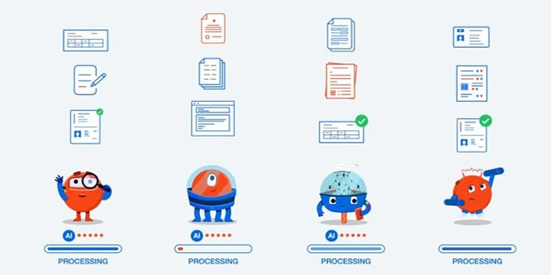

Task Capture Overview
UiPath Task Capture streamlines process documentation in automation projects.
It offers a user friendly interface for capturing and documenting tasks.
The tool automates the manual and time consuming process of creating documentation.
Users can create comprehensive documentation with detailed steps, screenshots, and annotations.

Slide 4

The way to get started is to quit talking and begin doing.
Task Capture Key Features
Walt Disney

Slide 5
User friendly interface for easy navigation and usage.
Automated process discovery to accelerate documentation.
Multilevel process mapping for detailed representation.
Collaboration and sharing features for team efficiency.
Customizable templates for consistent documentation across projects.
Integration with UiPath Studio for a seamless automation development lifecycle.

Slide 6
The way to get started is to quit talking and begin doing.
How to Use UiPath Task Capture
Walt Disney

Slide 7
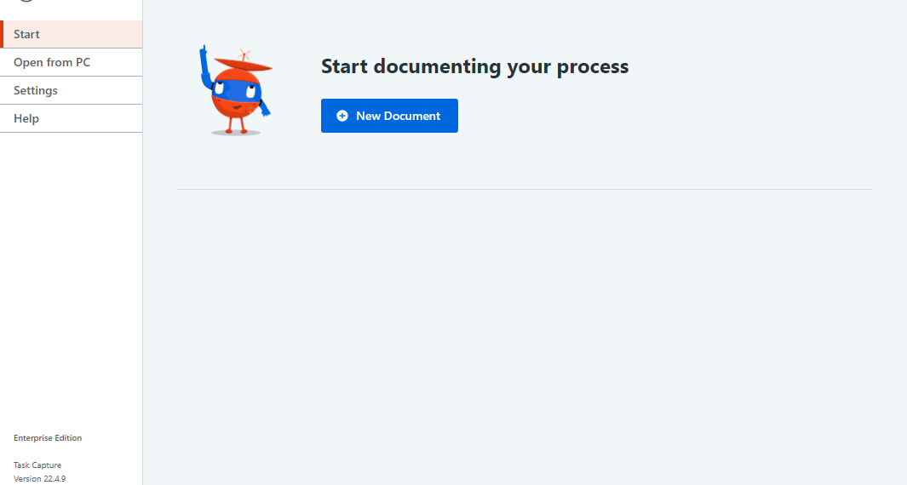
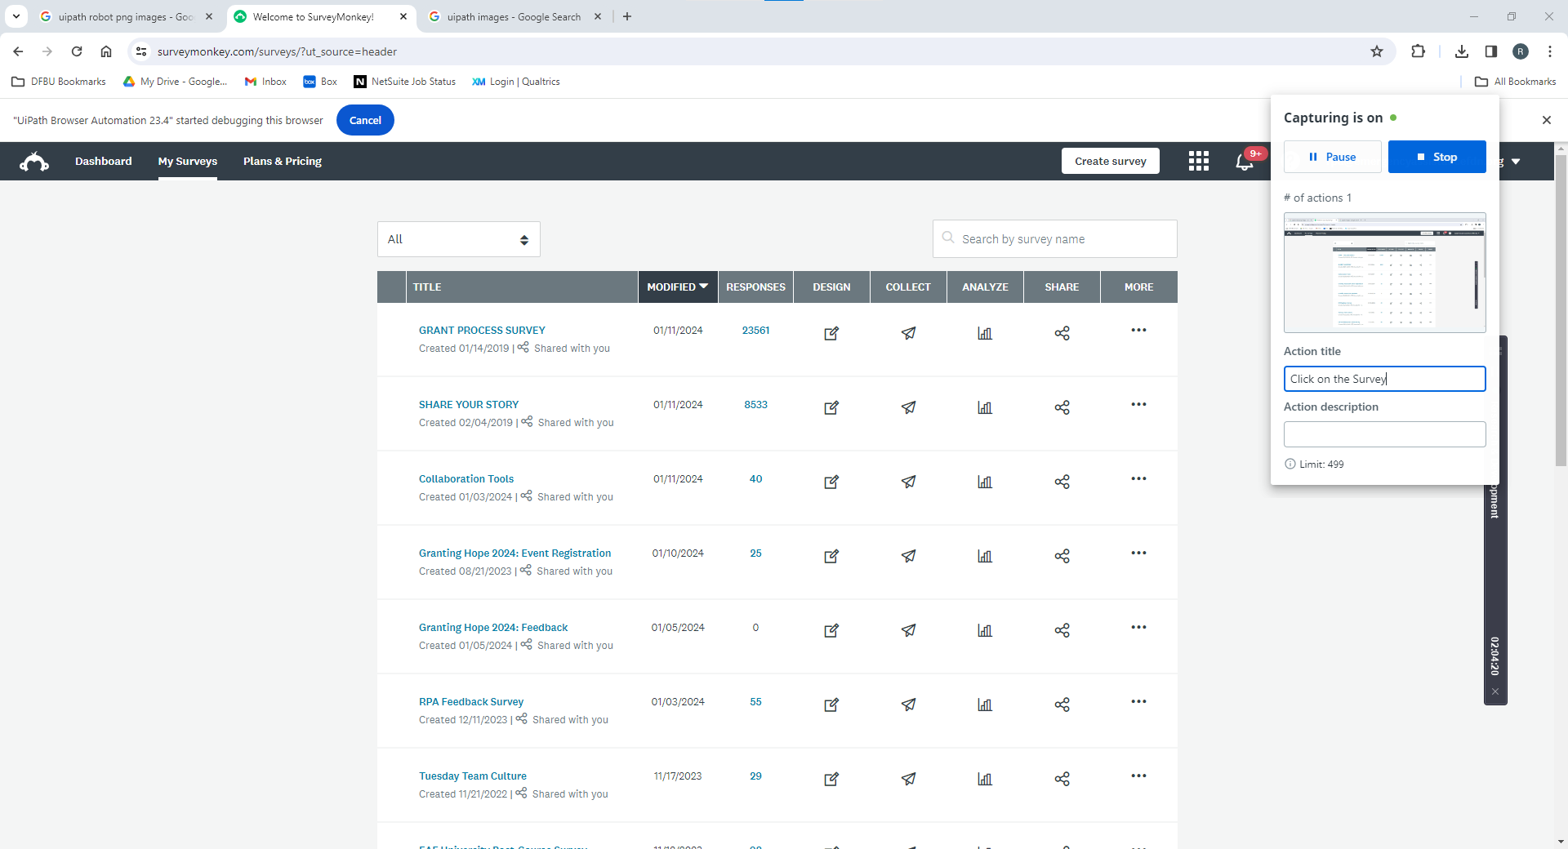
Open Task Capture and start a new project.
Capture tasks by interacting with the application or process.

Slide 8
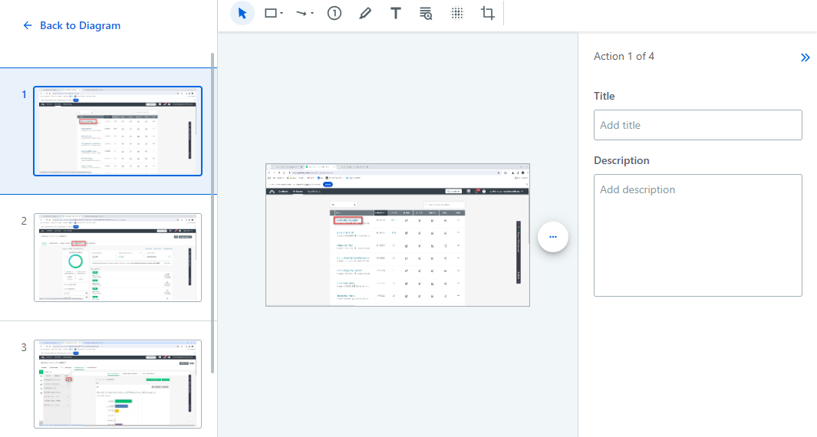
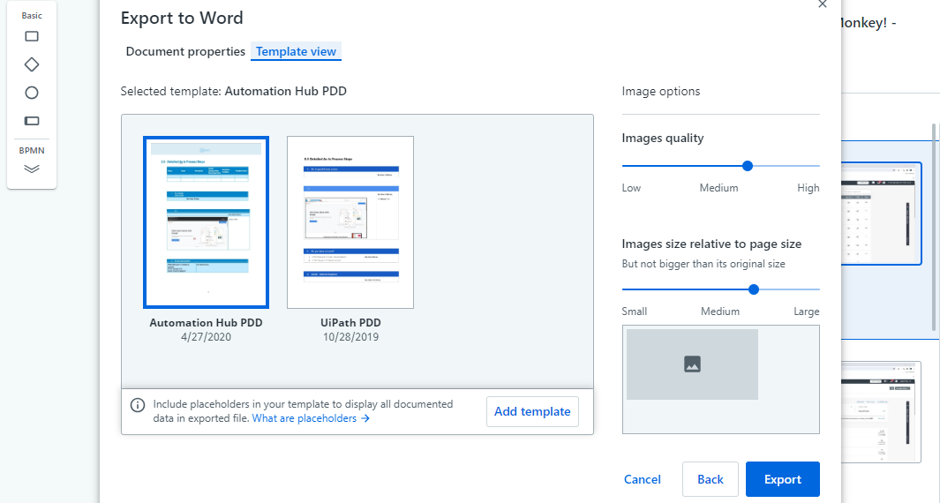
Edit and refine the captured steps as needed.
Utilize customizable templates for consistent documentation.

Slide 9
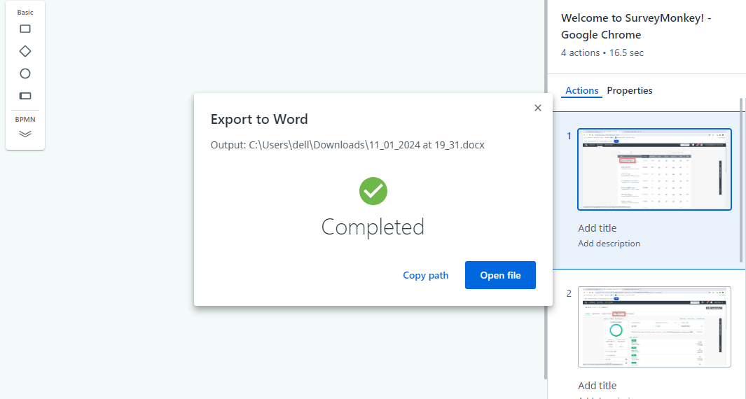
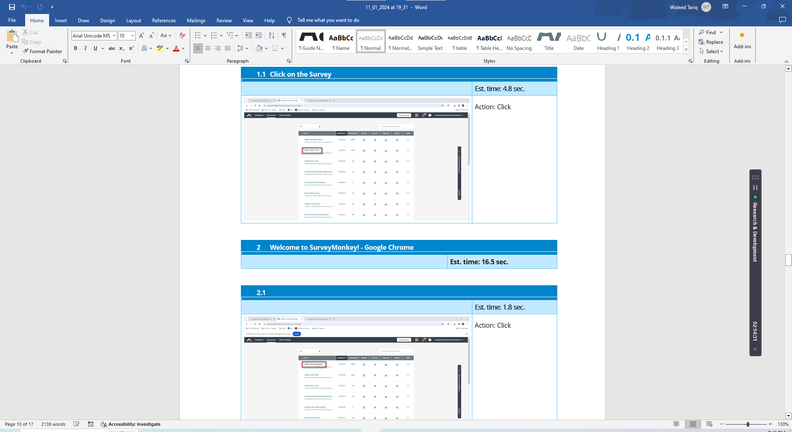
Save and export the documentation for further use.

Slide 10
The way to get started is to quit talking and begin doing.
Benefits of Task Capture
Walt Disney

Slide 11
Streamlined Process Documentation:
Task Capture simplifies and accelerates the process of documenting tasks within automation projects.
User-Friendly Interface:
The tool provides a user-friendly interface, making it accessible for users with varying levels of technical expertise.
Integration with UiPath Studio:
Task Capture seamlessly integrates with UiPath Studio, enhancing collaboration between documentation and automation development teams.
Time and Effort Savings:
By automating the traditionally manual process of documentation, Task Capture saves time and effort, allowing teams to focus on more critical aspects of automation.
Comprehensive Documentation:
Users can create comprehensive documentation with detailed steps, screenshots, and annotations, ensuring a thorough understanding of the processes.

Slide 12

Thank You
Waleed Tariq
Tariq@emergencyassistancefdn.org

